Slide 1
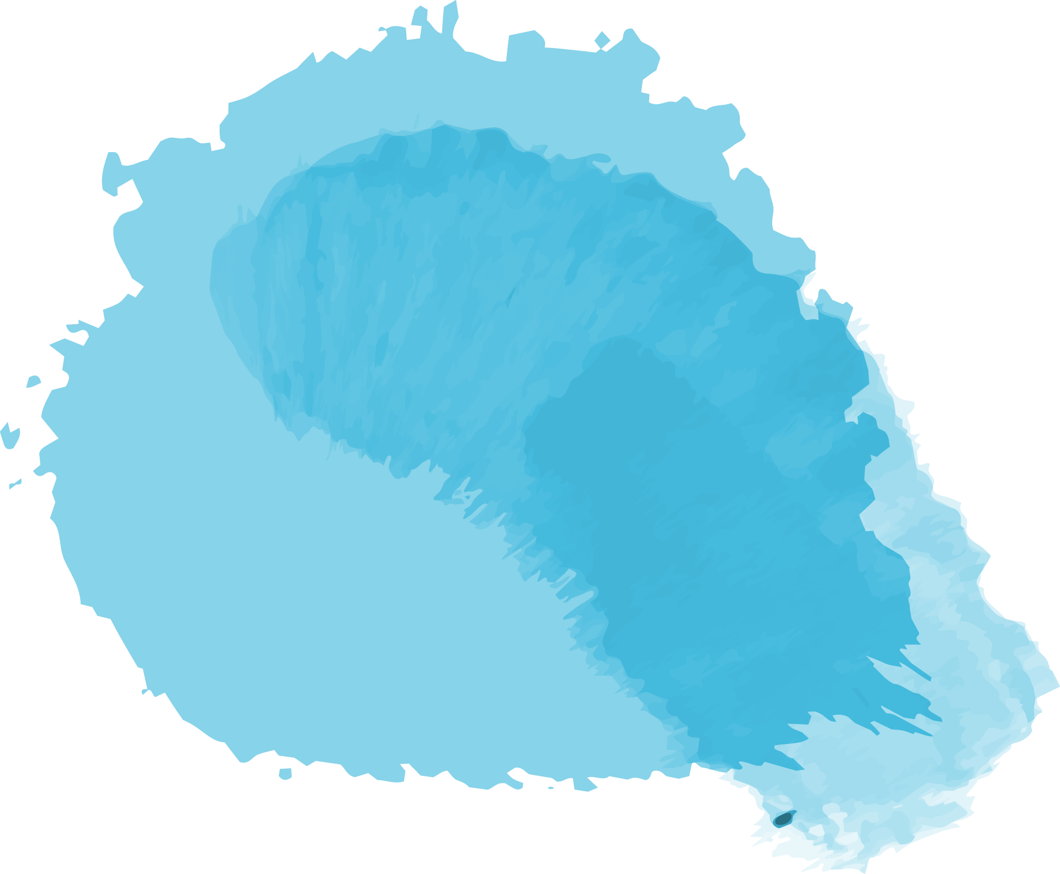
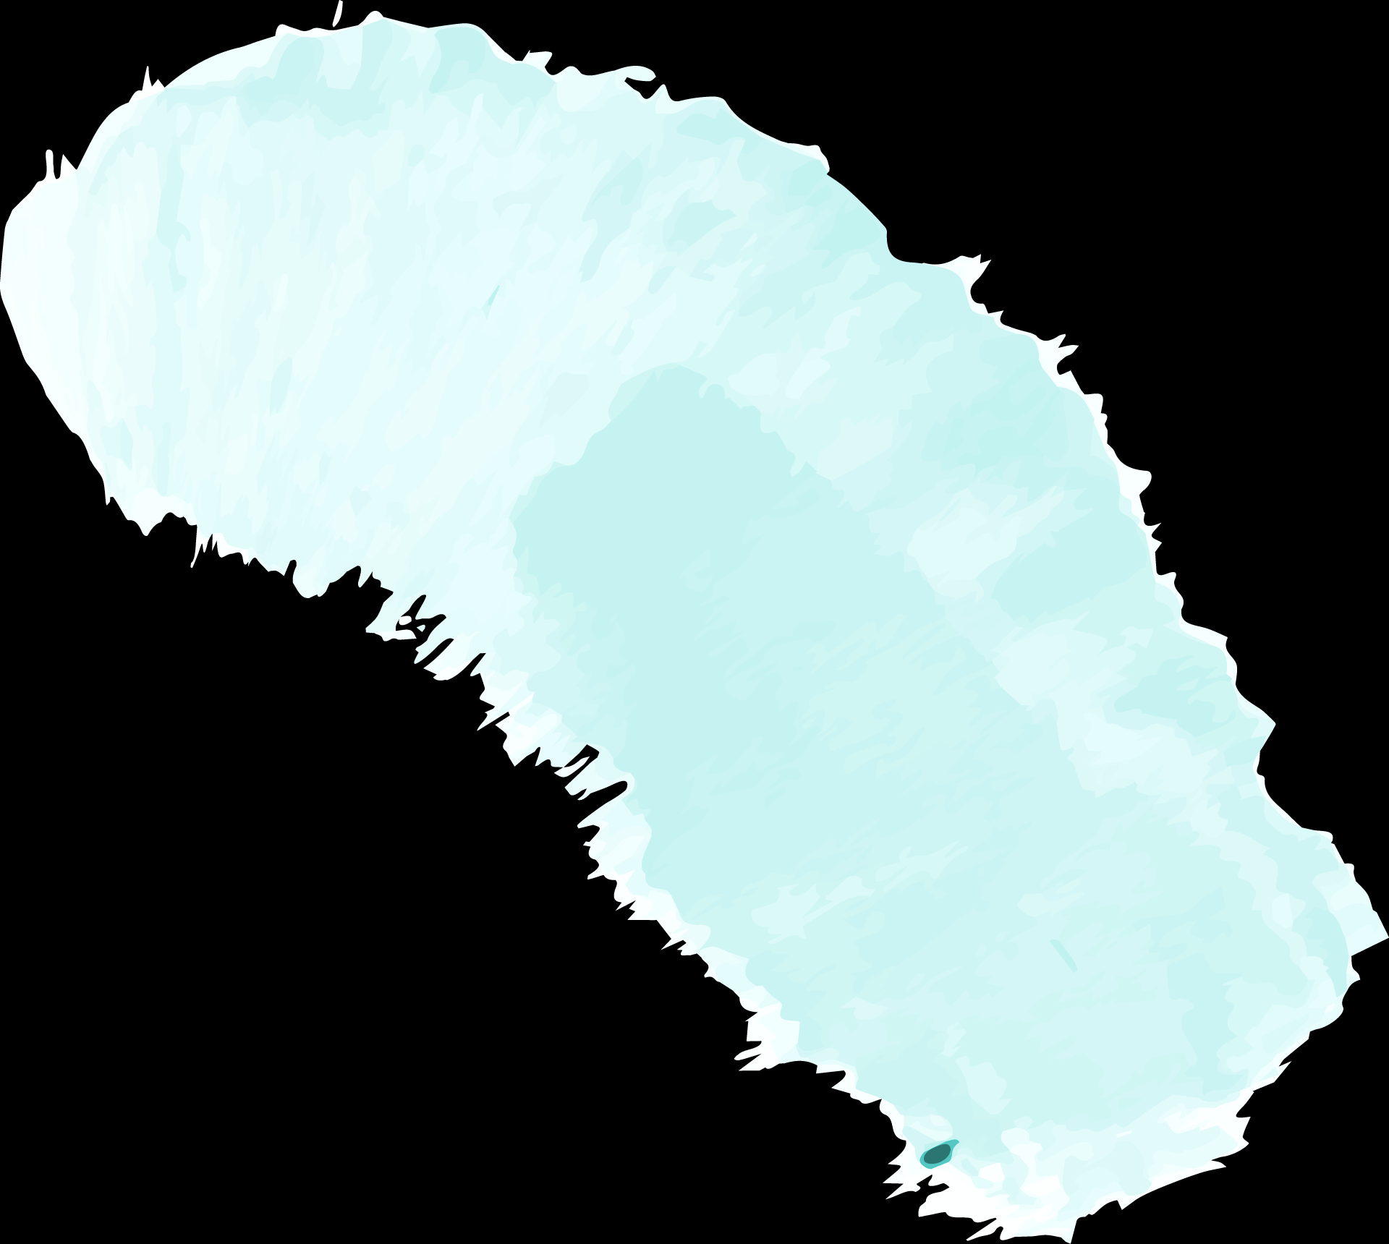

Algorithms for Exploration and Exploitation in Reinforcement Learning
19MAT204
MIS-3
TEAM-05

Slide 2
Our Team
LOGESH KSR
MEKAPATI SPANDANA REDDY
PALETI NIKHIL CHOWDARY
PRANAV UNNIKRISHNAN
ROHAN SANJEEV
CB.EN.U4AIE20032
CB.EN.U4AIE20038
CB.EN.U4AIE20046
CB.EN.U4AIE20053
CB.EN.U4AIE20059

Slide 3
INTRODUCTION

Slide 4
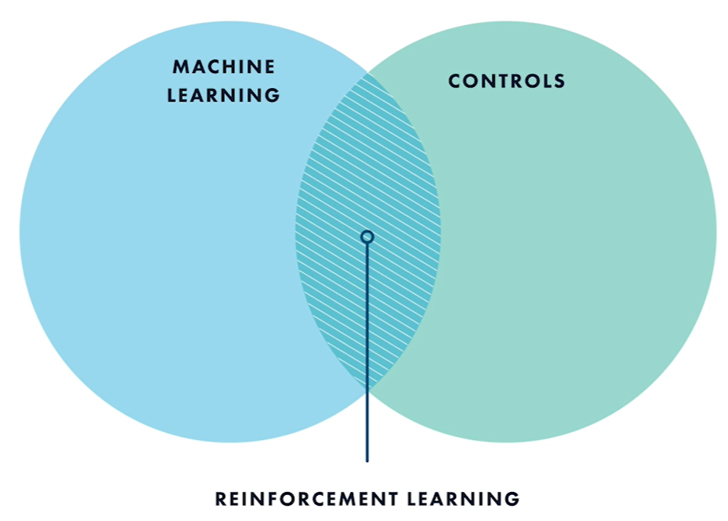
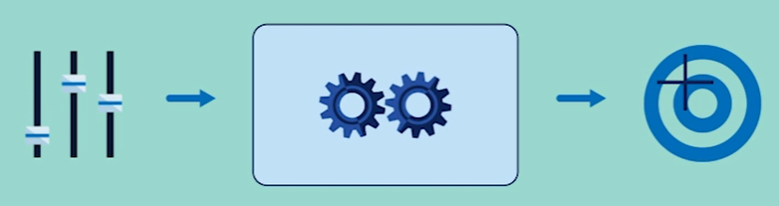
Notes:
Reinforcement learning is a machine learning technique for control problems– that is, applications where you want to choose actions to achieve a particular goal

Slide 5
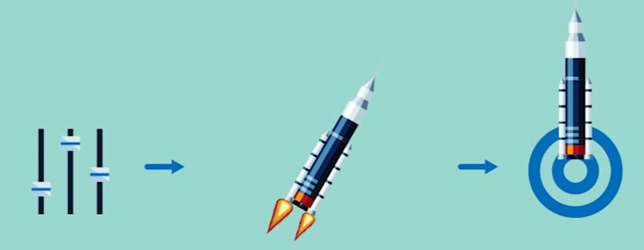
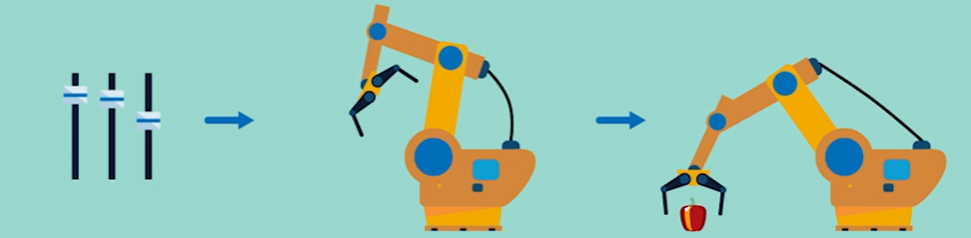
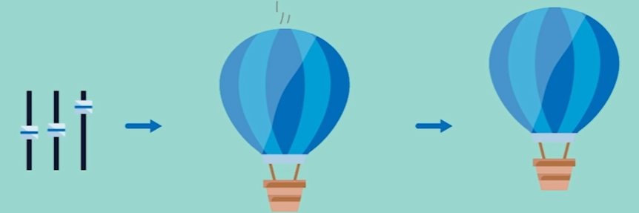
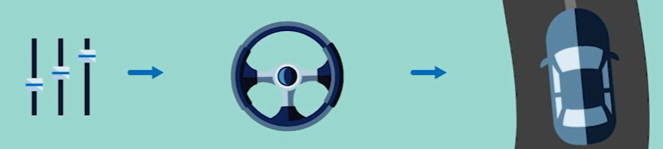
Notes:
When should we fire rockets to land the probe gently?
How much torque should we apply to robotic joint to have it pick up an object?

Slide 6
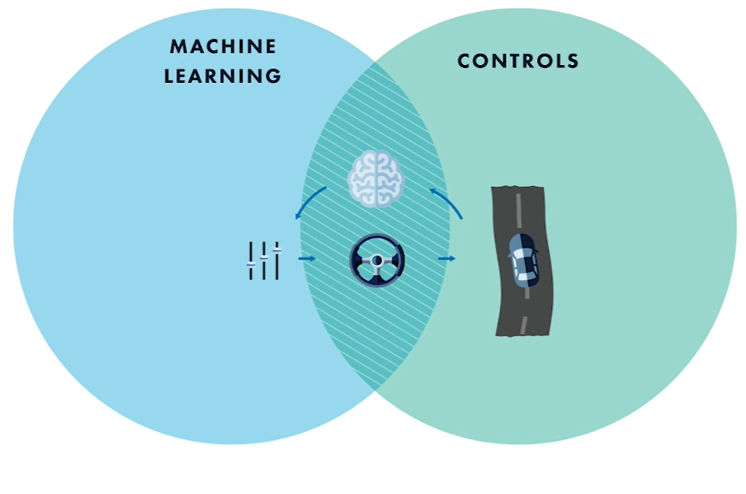
Notes:
The goal of reinforcement learning is to build a smart controller that will choose best action to take in a given situation.
It’s a machine learning technique because the choice of action is learnt from experience.

Slide 7
Components in Reinforcement Learning

Slide 8
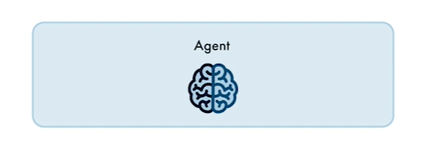
Agent
The brain that takes decisions about what to do in any given situation.

Slide 9
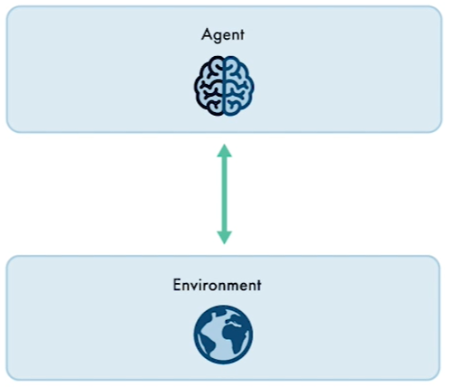
Environment
Agent interacts with the environment
The world that has rules about how things work and how the agent affects and is affected by the state of the world

Slide 10
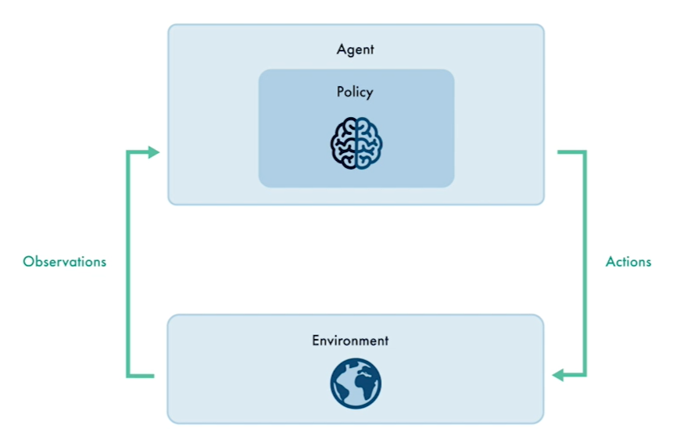
Policy
A rule for determining the action to take in a given situation.
Notes:
The point of reinforcement learning is to find a “good” policy.
But what does “good” mean?

Slide 11
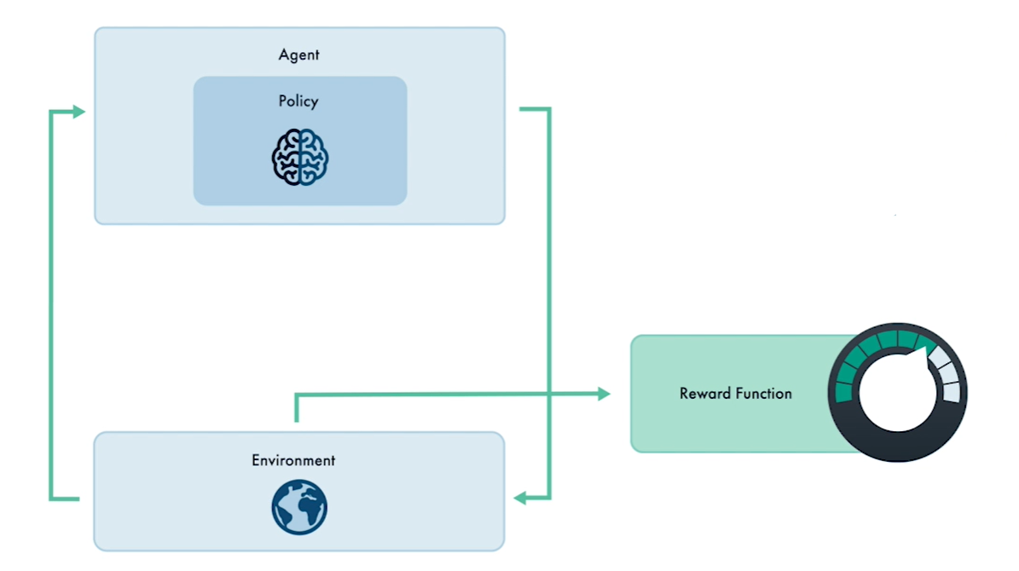
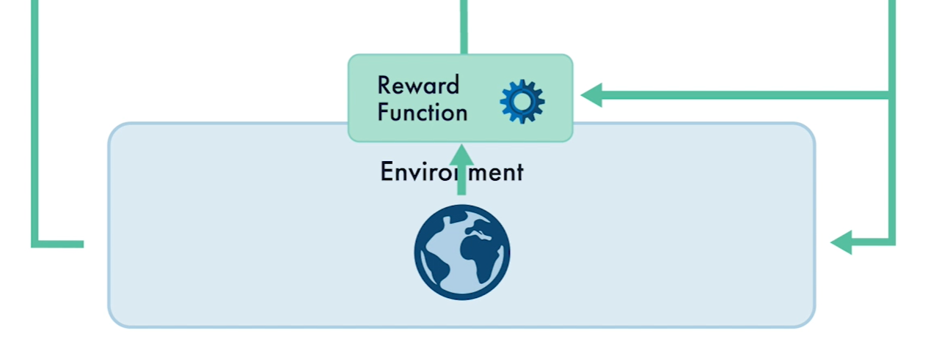
How good is our policy?
Rewards
actions
Notes:
In RL, we have a goal in mind, regarding what we want the agent to achieve.
From that goal, we will create a reward function that uses the current state of the environment to give some measure of how close the agent is to achieving its goal.
The reward encourages behaviour by giving high scores to states that we want to achieve and low scores to those we don’t
Also including the action taken to calculate reward function is also common when we want to factor in the cost of taking actions

Slide 12
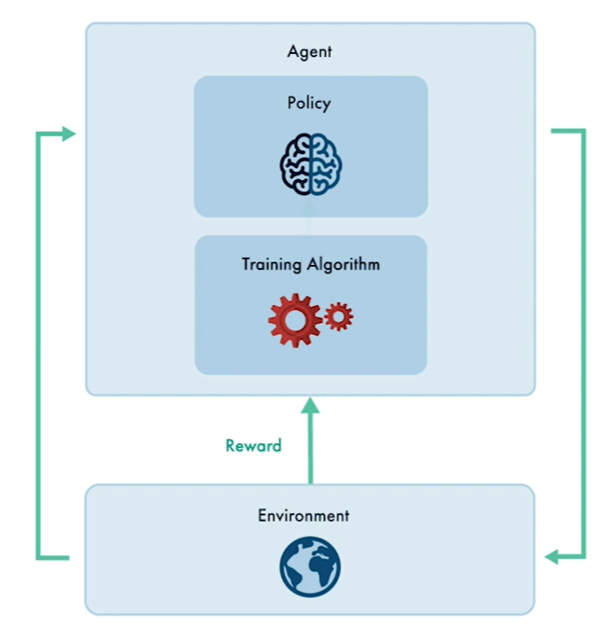
Training algorithm
Training algorithm tries to update policy towards actions that will receive more reward

Slide 13
AGENTS
Actors and Critics

Slide 14
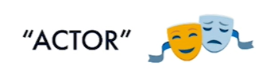

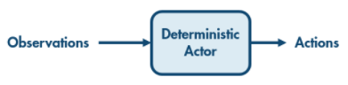
Actor
Actor maps observations to actions

Slide 15
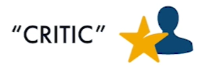
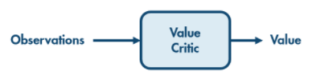
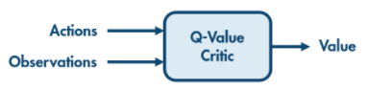
Critic
Critics don’t directly choose an action.
They just critique how good it is to be in a particular situation

Slide 16
Types of agents
1
2
3

Slide 17
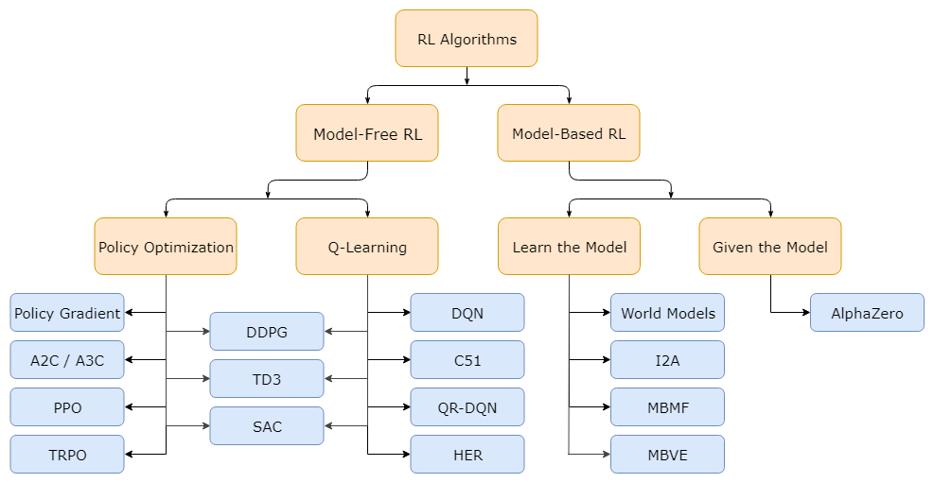
Model-Free and Model-Based
State, action, reward
State, action, probability, reward
Notes:
The main upside to having a model is that it allows the agent to plan by thinking ahead, seeing what would happen for a range of possible choices, and explicitly deciding between its options.
Algorithms which use a model are called model-based methods, and those that don’t are called model-free.
model-free methods are more popular and have been more extensively developed and tested than model-based methods.

Slide 18
On-policy vs Off-policy
An off-policy learner learns the value of the optimal policy independently of the agent's actions.
Example: Q-learning is an off-policy learner.
An on-policy learner learns the value of the policy being carried out by the agent including the exploration steps.
Example: SARSA is an on-policy learner

Slide 19
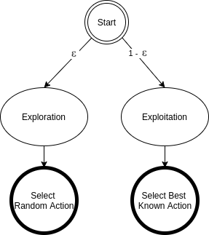
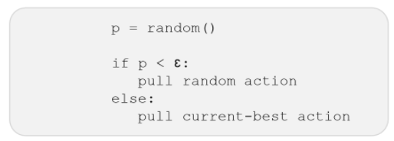
Exploration vs exploitation
Epsilon greedy
Start with high epsilon and decay it for good Exploration vs Exploitation

Slide 20
Algorithms Implemented
Q - learning
SARSA
DQN - Rohan sanjeev
REINFORCE with baseline - Spandana
PPO - Pranav
DDPG -Nikhil
-Logesh
Critic
Actor
Critic
+
Actor

Slide 21
01 Q-learning
Off policy
Model free
Discrete actions
Discrete States
Critic agent
Tabular representation of policy

Slide 22
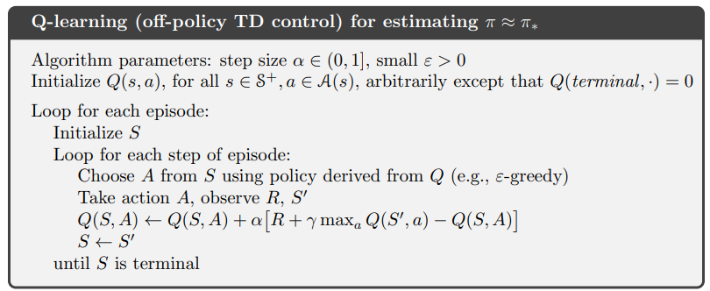
Q-learning Process
Initialize Q-Table
Choose an action from the Q-Table for the current state
Perform the chosen Action and transition to the Next state
Receive Reward and compute the temporal Differences
Update Q-Value for Previous state

Slide 23
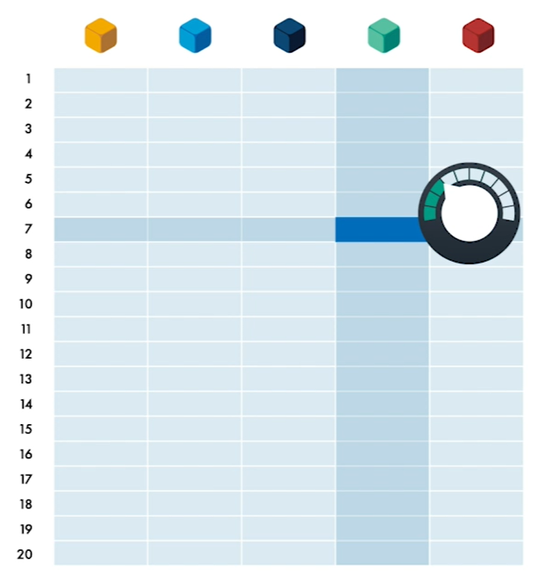
Q-table
Actions
How good is it to chose “green” when state is “7”
States
Each row for each unique state
Column = unique action

Slide 24
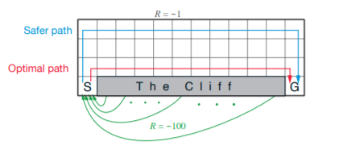
EXAMPLE : CLIFF-WALKING
The goal is to reach the particular location safely without falling down the cliff
48 states ( 0 to 47)
4 actions
-1 reward per move
-100 for falling in cliff

Slide 25
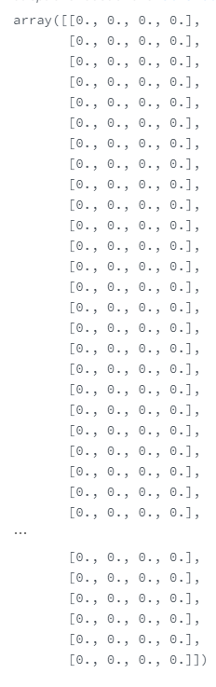
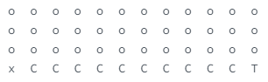
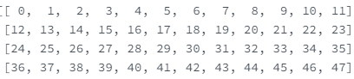
Q-table
States
48 x 4
Random values initially

Slide 26
How to update table?
Temporal difference
A method of calculating how much the Q-values for the action taken in the previous state should be changed based on AI agent has learned about the current state’s action.
The largest Q-value available for any action in the current state
The reward received for the action taken in the previous state
Temporal difference for the action taken in the previous state
The discount factor(between 0 and 1)
The Q-value for the action taken in the previous state

Slide 27
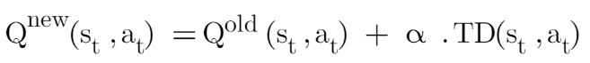
BELLMAN EQUATION
Relies on a both old Q-values for the action taken in the previous state and what has been learned after moving to the next state
Includes a learning rate parameter( )
The old Q-value for the action taken in the previous state
The temporal differences for the action taken in the previous state
The learning rate( between 0 and 1)
The new Q-value for the action taken in the previous state

Slide 28
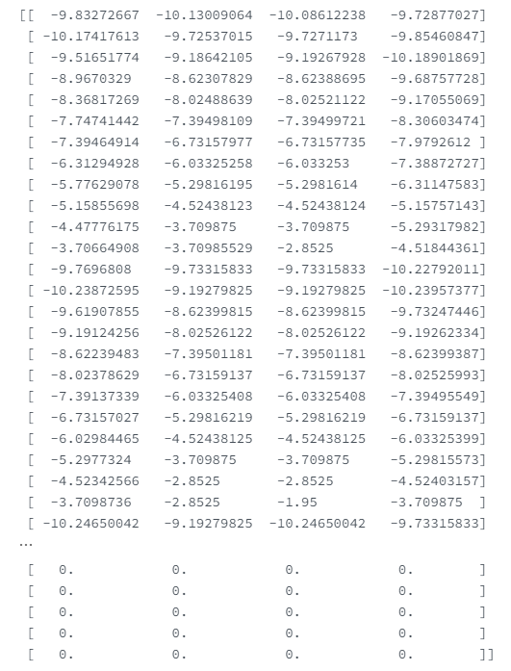
Final Q-table
States corresponding to cliff has
0 values

Slide 29
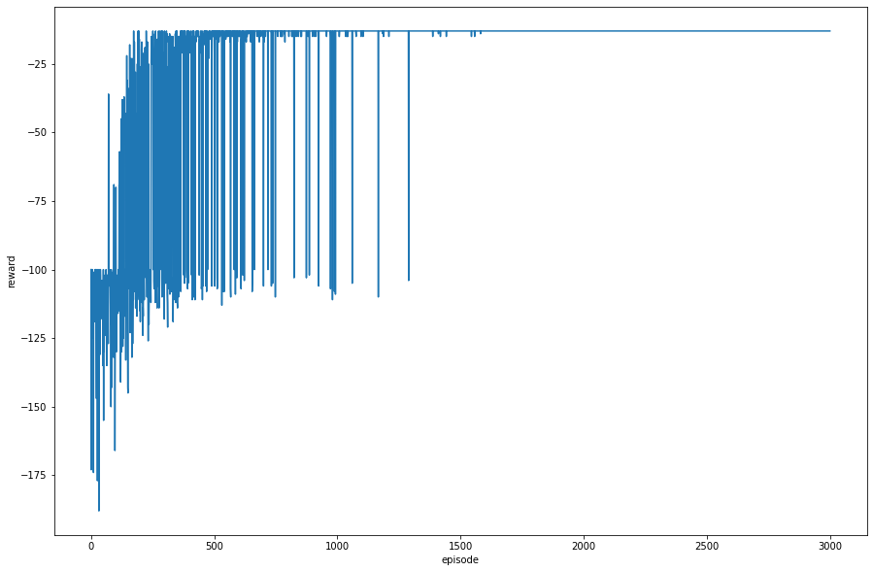

Slide 30
Demo

Slide 31
02 SARSA
On policy
Model free
Discrete actions
Discrete States
Critic agent
Tabular representation of policy

Slide 32
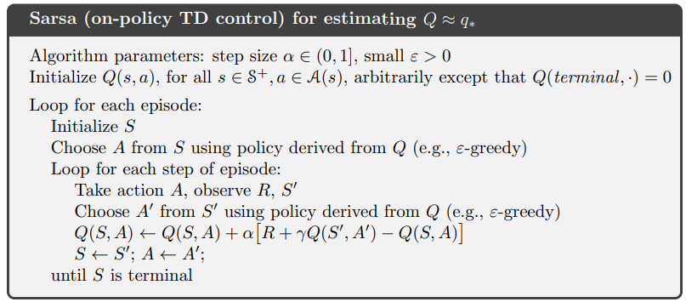
Sarsa Process
Initialize Q-Table
Choose an action from the Q-Table for the current state
Not there in Q learning
Perform the chosen Action and transition to the Next state
Choose the action from the next state
Receive Reward and compute the temporal Differences
Update Q-Value for Previous state

Slide 33
Temporal difference
A method of calculating how much the Q-values for the action taken in the previous state should be changed based on AI agent has learned about the current state’s action.
The largest Q-value available for any action in the current state
The reward received for the action taken in the previous state
Temporal difference for the action taken in the previous state
The discount factor(between 0 and 1)
The Q-value for the action taken in the previous state

Slide 34
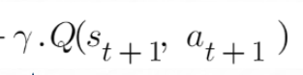
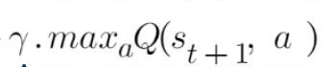
Sarsa Vs Q-learning
QL directly learns the optimal policy while SARSA learns a “near” optimal policy.
QL is a more aggressive agent, while SARSA is more conservative. An example is walking near the cliff. QL will take the shortest path because it is optimal (with the risk of falling), while SARSA will take the longer, safer route (to avoid unexpected falling).
Selected action in new state
SARSA
Q-learning

Slide 35
BELLMAN EQUATION
Relies on a both old Q-values for the action taken in the previous state and what has been learned after moving to the next state
Includes a learning rate parameter( )
The old Q-value for the action taken in the previous state
The temporal differences for the action taken in the previous state
The learning rate( between 0 and 1)
The new Q-value for the action taken in the previous state

Slide 36
OUR IMPLEMENTATION

Slide 37
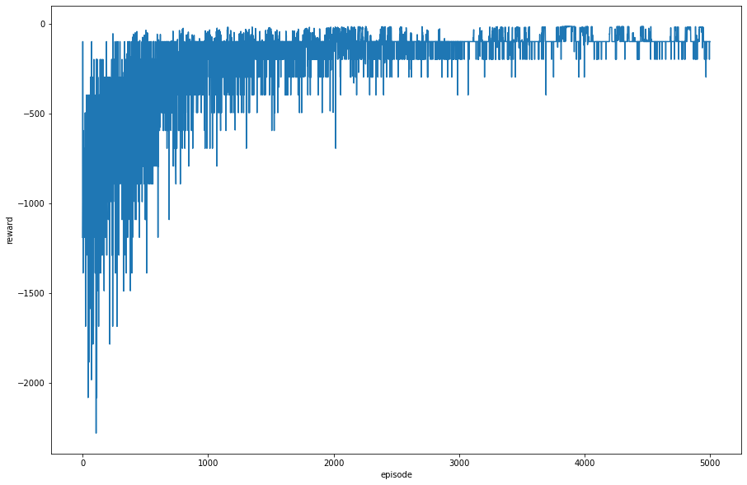
Cliff walking

Slide 38
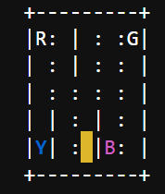
Environment
500 states
6 actions
Up
Down
Left
Right
Pickup
drop
Taxi
Passenger
Taxi with passenger
destination
When the episode starts, the taxi starts off at a random square and the passenger is at a random location. The taxi drives to the passenger's location, picks up the passenger, drives to the passenger's destination (another one of the four specified locations), and then drops off the passenger.

Slide 39
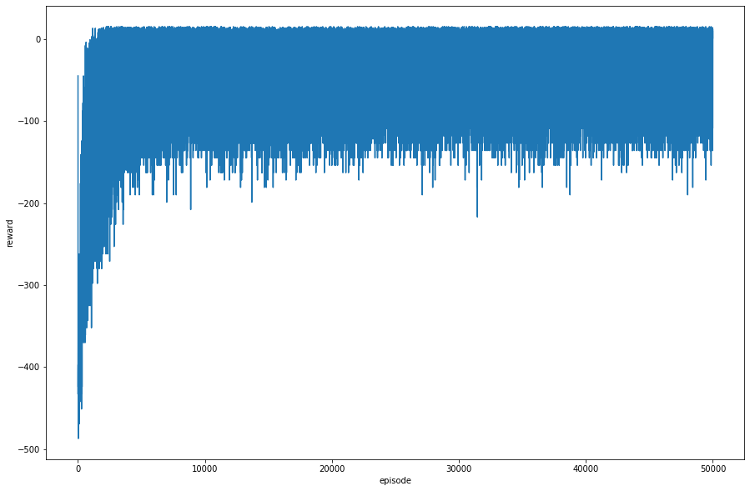

Slide 40
Demo

Slide 41
03 DQN
Off policy
Model free
Discrete actions
Continuous or Discrete States
Critic agent
Neural network representation of policy

Slide 42
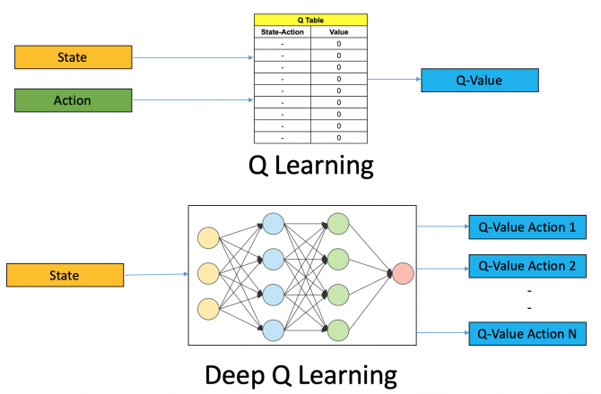

Slide 43
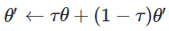
Variations of DQN
DQN with 1 network (original and old)
DQN with 2 networks [hard update](2nd network updated per x episodes)
DQN with 2 networks (soft update) [inspired from ddpg]
2nd network is updated with x% of weights from 1st network every episode

Slide 44
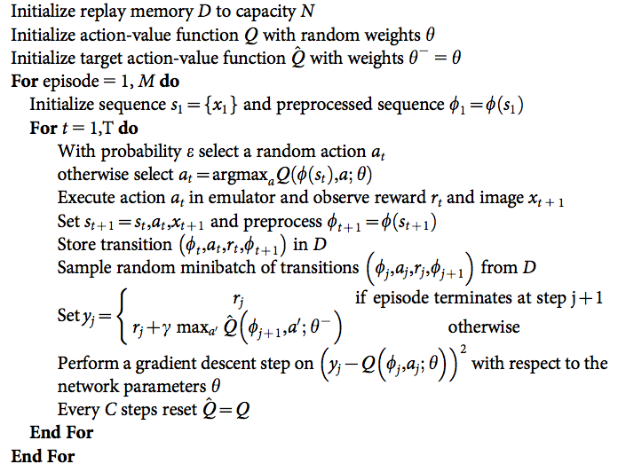
Algorithm for two networks with hard update

Slide 45
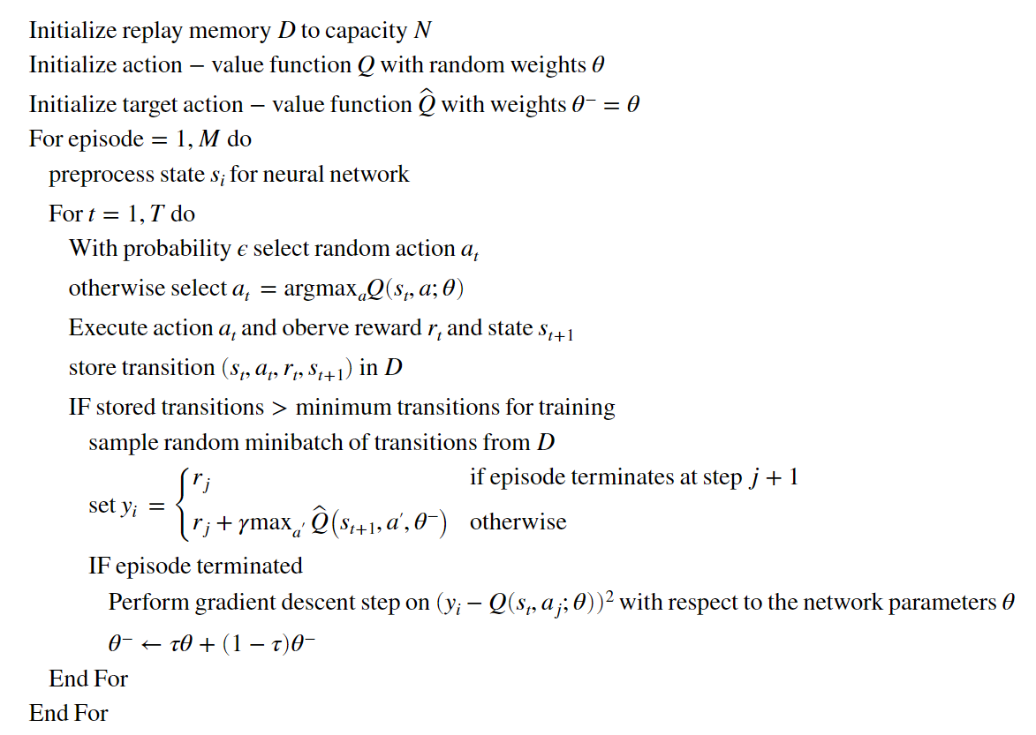
OUR VARIATION
Two networks - trained every episode - soft update
Updating the network

Slide 46
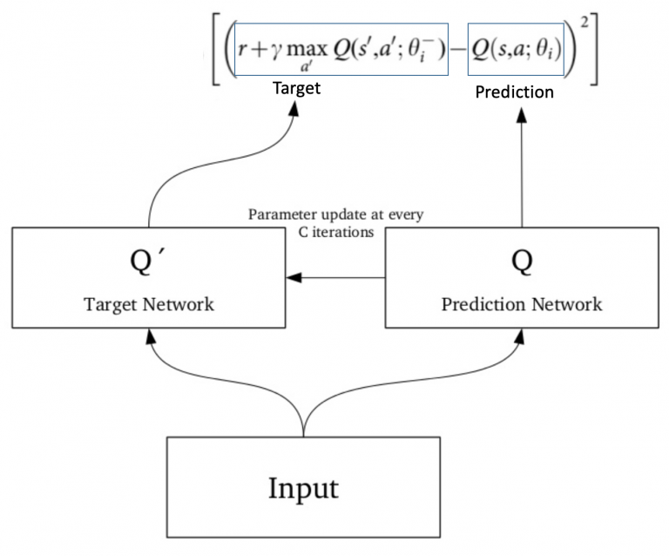
Gradient descent step:
(Update for first network)
First network
Second network

Slide 47
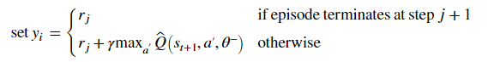
We have 32 (state, action, reward, new_state), two neural networks
Using 32 state & first neural network,
Using 32 new_state & second neural network,
 | Action 1 Q value | Action 2 Q value
state1 | 78 | 15
state2 | 10 | 20
 | : | :
 | Action 1 Q value | Action 2 Q value
New state1 | 25 | 96
New state2 | 62 | 30
 | : | :
Give states

Slide 48
OUR IMPLEMENTATION

Slide 49
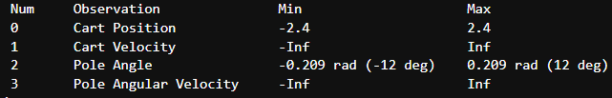
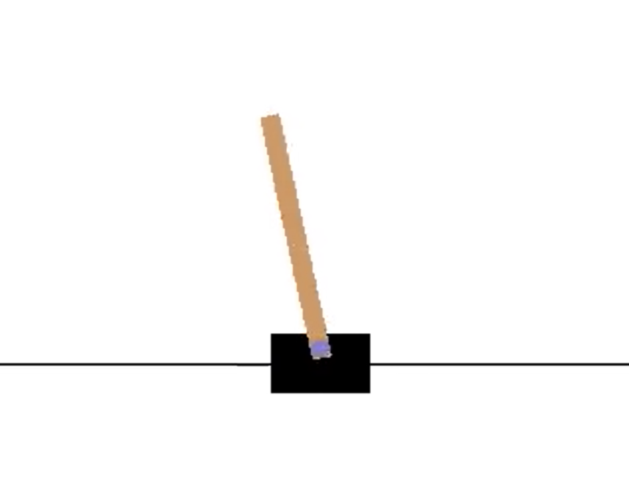
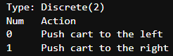
Environment
cartpole
goal is to prevent it from falling over by increasing and reducing the cart's velocity.

Slide 50
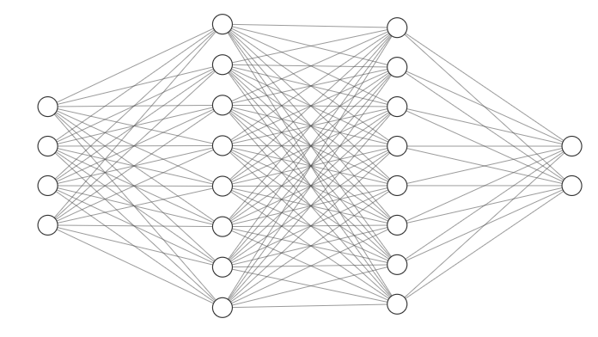
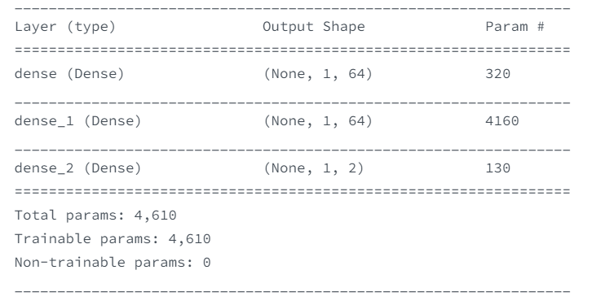
Two networks architecture:
64 neurons,
Relu activation
64 neurons,
Relu activation
4 input
2 output

Slide 51
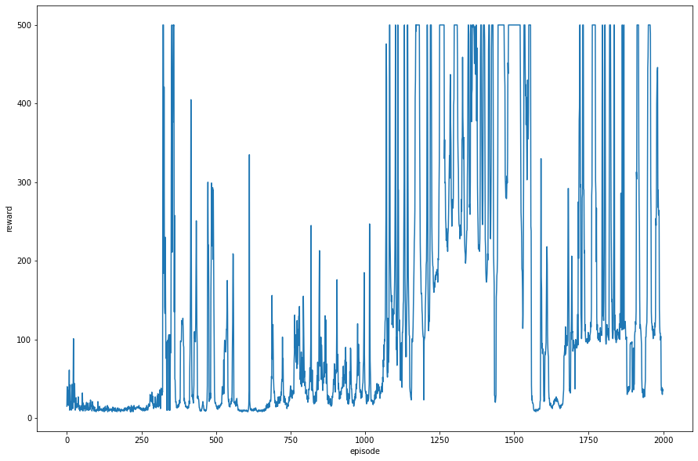
Trained 2000 episodes for 11 hours 17 minutes
Between 1450 and 1500 episodes, we have best model and saved:
average reward = 458.02, min=279.0, max=500.0

Slide 52
Demo

Slide 53
04 Reinforce with baseline
On policy
Model free
Discrete actions
Continuous or Discrete States
Actor agent
Neural network representation of policy

Slide 54

Q-learning, Sarsa, DQN derived policy from optimal value function
policy gradient methods directly learn the policy by parameterizing it as:
Aim: learn the best parameters theta

Slide 55




Optimization problem
For discrete variables expectation can be computed with a summation
Gradient ascent

Slide 56





Differentiate both sides with respect to parameter theta

Slide 57



Looking into:
log

Slide 58



Differentiate with respect to theta
Note that, the is not dependent on policy parameter (theta), its assumed that the state transition is unknown to the agent in model free RL so,

Slide 59



Slide 60



If we want to use discount factor

Slide 61

REINFORCE algorithm

Slide 62

Policy gradient with baseline

Slide 63

Policy gradient with baseline
New neural network for baseline

Slide 64
OUR IMPLEMENTATION

Slide 65
Environment
cartpole
goal is to prevent it from falling over by increasing and reducing the cart's velocity.

Slide 66


Network architecture
64 neurons
64 neurons
2 outputs
1 output
4 inputs
4 inputs
POLICY NETWORK
BASELINE NETWORK

Slide 67

Trained on cartpole for 100 episodes
Policy gradient methods converge better than DQN!!!!

Slide 68
Final model demo

Slide 69
05 PPO
On policy
Model free
Discrete actions
Continuous or Discrete States
Actor + critic agent
Neural network representation of policy

Slide 70

Variants of PPO
PPO-Penalty: solves KL-constrained update like TRPO
PPO-Clip: No KL-divergence term in objective and no constraint at all.
Relies on clipping in the objective function to remove incentives for the new policy to get far from the old policy
Primary variant used at OpenAI

Slide 71


Slide 72


Actor
value
Critic

Slide 73



Instead of the log of current policy, we will be taking the ratio of current policy and old policy.

Slide 74


Slide 75
Algorithm steps
Play game for n steps and store state, action probability, rewards, done variables.
Apply the Generalized Advantage Estimation method on the above experience.
Train neural networks for some epochs by calculating their respective loss.

Slide 76
Actor loss
PPO uses a ratio between the newly updated policy and the old policy in the update step.
Computationally, it is easier to represent this in the log form:
ratio = exp(log(prob) — log(old_prob));
Using this ratio we can decide how much of a change in policy we are willing to tolerate.
we use a clipping parameter LOSS_CLIPPING to ensure we only make the maximum percent change to our policy at a time. Paper suggests using this value as 0.2:
p1 = ratio*advantages p2 = clip(ratio, min_value=1 — LOSS_CLIPPING, max_value=1+LOSS_CLIPPING)*advantages;
Actor loss is calculating by simply getting a negative mean of element-wise minimum value of p1 and p2;
Adding an entropy term is optional, but it encourages our actor model to explore different policies and the degree to which we want to experiment can be controlled by an entropy beta parameter.

Slide 77
Critic loss
value_loss = K.mean((y_true - y_pred) ** 2) # standard PPO loss
Better version by clipping y_preds:
LOSS_CLIPPING = 0.2
clipped_value_loss = values + clip(y_pred - values, -LOSS_CLIPPING, LOSS_CLIPPING)
v_loss1 = (y_true - clipped_value_loss) ** 2
v_loss2 = (y_true - y_pred) ** 2
value_loss = 0.5 * K.mean(K.maximum(v_loss1, v_loss2))

Slide 78
GAE - Generalized Advantage Estimation
Initialize variables gamma and lambda.
We loop reward from back by reversing the reward list.
Calculate delta as (the reward of current action + gamma * value of next state * done variable which is zero for the terminal state - the value of current state).
Calculate variable “g” as (delta + gamma * lambda * done variable* g).
Calculate return as (g + value of current state).
Reverse the return list as we did calculations from backward.
The advantage is calculated as ( returns — values).
Gamma is discount factor
Lambda is a smoothing parameter used for reducing the variance in training which makes it more stable.
At last, we subtract the mean and divide by standard deviation

Slide 79
OUR IMPLEMENTATION

Slide 80

Environment
8 continuous observations
(position, velocity etc.,)
Four discrete actions available:
do nothing,
fire left orientation engine,
fire main engine,
fire right orientation engine.
Reward for moving from the top of the screen to landing pad and zero speed is about 100..140 points.
Episode finishes if the lander crashes or comes to rest, receiving additional -100 or +100 points. Each leg ground contact is +10. Firing main engine is -0.3 points each frame.
Goal:
Land the rover between the two flags with zero velocity

Slide 81


Network architecture
512
256
64
512
256
64
1 output
4 outputs
8 inputs
8 inputs
Actor network
Critic network

Slide 82


Slide 83
Final model demo

Slide 84
05 DDPG
Off policy
Model free
Continuous actions
Continuous States
Actor + critic agent
Neural network representation of policy

Slide 85

DDPG uses four neural networks:

Slide 86

Network
updates

Slide 87

Critic update
with tf.GradientTape() as tape:
A2 = self.mu_target(X2)
q_target = R + self.gamma * self.q_mu_target([X2,A2])
qvals = self.q_mu([X,A])
q_loss = tf.reduce_mean((qvals - q_target)**2)
grads_q = tape.gradient(q_loss,self.q_mu.trainable_variables)
self.q_mu_optimizer.apply_gradients(zip(grads_q, self.q_mu.trainable_variables))
self.q_losses.append(q_loss)

Slide 88
Actor update
with tf.GradientTape() as tape2:
A_mu = self.mu(X)
Q_mu = self.q_mu([X,A_mu])
mu_loss = -tf.reduce_mean(Q_mu)
grads_mu = tape2.gradient(mu_loss,self.mu.trainable_variables)
self.mu_losses.append(mu_loss)
self.mu_optimizer.apply_gradients(zip(grads_mu, self.mu.trainable_variables))

Slide 89

Target network update
temp1 = np.array(self.q_mu_target.get_weights())
temp2 = np.array(self.q_mu.get_weights())
temp3 = self.tau*temp2 + (1-self.tau)*temp1
self.q_mu_target.set_weights(temp3)
temp1 = np.array(self.mu_target.get_weights())
temp2 = np.array(self.mu.get_weights())
temp3 = self.tau*temp2 + (1-self.tau)*temp1
self.mu_target.set_weights(temp3)

Slide 90

Exploration
In the DDPG paper, the authors use Ornstein-Uhlenbeck Process to add noise to the action output (Uhlenbeck & Ornstein, 1930)
The Ornstein-Uhlenbeck Process generates noise that is correlated with the previous noise, as to prevent the noise from canceling out or “freezing” the overall dynamics

Slide 91
OUR IMPLEMENTATION

Slide 92



Environment
Swing the pendulum upright
Cost = - ( theta** 2 + 0.1 * thetadot ** 2 + 0.001 * (action ** 2) )

Slide 93
Networks
Actor Networks
Observation space
512
200
128
Action space
Critic Networks
Observation space, action
1024
512
300
1

Slide 94


Slide 95
Final model demo

Slide 96
🥳🎉 What we implemented
 | Discrete Action | Continuous Action
Discrete states | Q-learning (cliff problem), Sarsa (Taxi) | X
Continuous states | DQN(cartpole), Reinforce (cartpole), PPO(LunarLanding) | DDPG(pendulum)
Actor
Critic
Actor + Critic

Slide 97
References
Reinforcement Learning: An Introduction by Sutton and Barto
MATLAB Reinforcement learning ONRAMP
http://artint.info/html/ArtInt_268.html
https://spinningup.openai.com/en/latest/user/introduction.html
https://ai.stackexchange.com/questions/21485/how-and-when-should-we-update-the-q-target-in-deep-q-learning/21486
https://www.analyticsvidhya.com/blog/2019/04/introduction-deep-q-learning-python/
https://pylessons.com/CartPole-DDQN/
https://medium.com/@leosimmons/double-dqn-implementation-to-solve-openai-gyms-cartpole-v-0-df554cd0614d
https://towardsdatascience.com/policy-gradient-reinforce-algorithm-with-baseline-e95ace11c1c4
https://medium.com/@thechrisyoon/deriving-policy-gradients-and-implementing-reinforce-f887949bd63

Slide 98
https://towardsdatascience.com/proximal-policy-optimization-ppo-with-tensorflow-2-x-89c9430ecc26
https://github.com/abhisheksuran/Reinforcement_Learning/blob/master/PPO.ipynb
https://pylessons.com/LunarLander-v2-PPO/
https://github.com/pythonlessons/Reinforcement_Learning/blob/master/LunarLander-v2_PPO/LunarLander-v2_PPO.py
https://jonathan-hui.medium.com/rl-proximal-policy-optimization-ppo-explained-77f014ec3f12
https://towardsdatascience.com/deep-deterministic-policy-gradient-ddpg-theory-and-implementation-747a3010e82f
https://towardsdatascience.com/deep-deterministic-policy-gradients-explained-2d94655a9b7b

Slide 99
Thank You!!!!

